Slide 1

DECODELABS · BUSINESS INTELLIGENCE
From order data to executive action
Business Intelligence Review · Jan 2023 – Jun 2025
Notes:
Opening context: DecodeLabs order data from January 2023 through June 2025. This deck translates 1,200 raw order records into four immediate executive decisions.

Slide 2
EXECUTIVE SUMMARY
Revenue is material, but fulfilment is the constraint
£1.26m
1,200
19.2%
41.4%
GROSS ORDER VALUE
TOTAL ORDERS
DELIVERED RATE
CANCELLED OR RETURNED
Recorded across all 1,200 orders and statuses
Placed between Jan 2023 and Jun 2025
Only 231 orders confirmed delivered to customers
497 orders lost to fulfilment and product friction
Decision lens: Optimise for completed, retained customer orders rather than chasing gross order intake. More top-of-funnel demand compounds warehouse and return losses until fulfilment friction is resolved.
Notes:
Top takeaway: of the headline £1.26m order value, less than a fifth is verified delivered. 41.4% of placed orders leak straight into cancellations and returns.

Slide 3
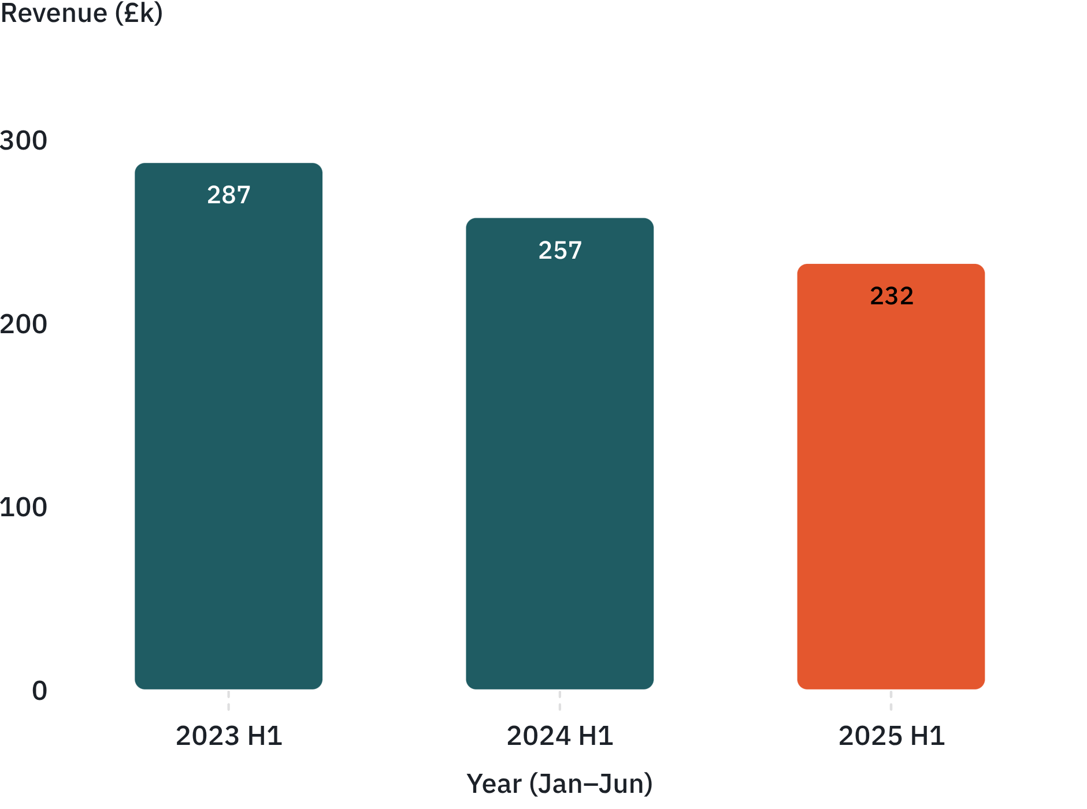
TOP-LINE TRAJECTORY
Revenue is declining, and 2025 is only six months
LIKE-FOR-LIKE FIRST-HALF REVENUE (£K)
CORE DIAGNOSIS
Full-year revenue contracted 13.1%: £553k in 2023 dropped to £480k in 2024.
Like-for-like H1 fell two consecutive years: £287k to £257k to £232k. H1 2025 is down 9.8% on 2024 and 10.3% on 2023.
The decline is not just the partial year; the data does not show the cause.
3
Notes:
Do not let the partial-year calendar excuse the drop: like-for-like first-half run rates show revenue fell from £287k to £232k across three successive years.

Slide 4
REVENUE DYNAMICS
Monthly revenue is volatile, so diagnose drivers, not totals
£68.1k
£27.8k
PEAK MONTH · JUN 2024
LOW MONTH · APR 2023
Highest monthly billing across the 30-month dataset
Trough monthly billing; a 2.4× spread peak to trough
NEXT CUTS
EXECUTIVE ACTION
Order count and average order value swings to detect discounting; product and source mix, product margin variations and referral source contribution by month.
Cancellation and return rates by order month, not resolution date. High revenue months often coincide with heavy subsequent returns.
A weekly trading pack with comparable-period revenue, fulfilled orders, completed fulfilment rates and status conversion pipeline.
Top-line totals mask shifts between order volume, basket size and status conversion.
4
Notes:
Topline aggregates swing by up to £40k month-to-month. Management needs a driver model: order count, AOV, mix, and net completion.

Slide 5
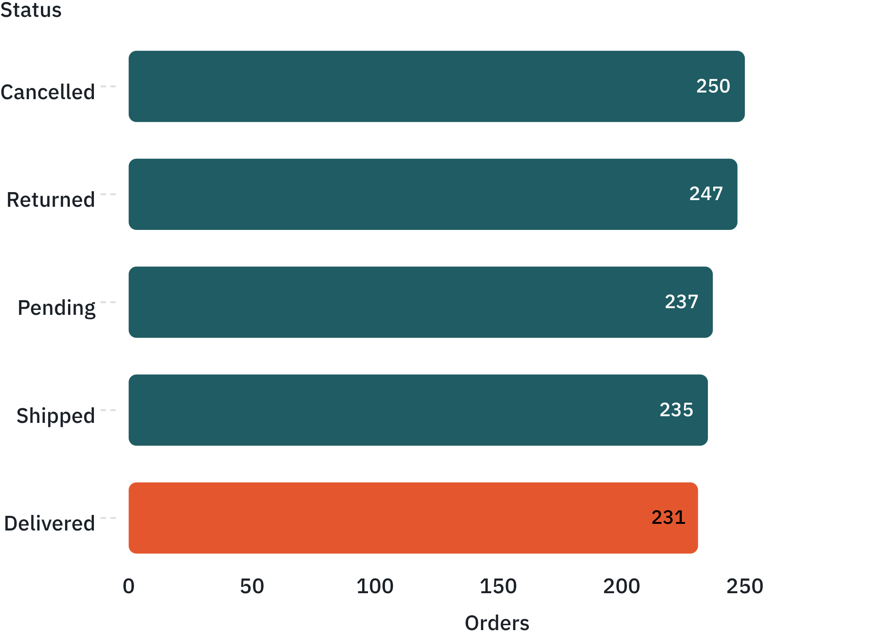
FULFILMENT PIPELINE
Only 1 in 5 orders is marked delivered
ORDER COUNT BY STATUS (1,200 TOTAL)
REVENUE AT RISK
231 delivered (19.2%); 497 cancelled or returned (41.4%).
£519k in failed fulfilment: £276k sits in cancelled orders and £243k in returned stock.
472 orders in limbo: Pending (237) and Shipped (235) represent £496k of unconfirmed sales.
Until dispatch and courier tracking feed confirmed delivery timestamps, neither pending nor shipped orders can be booked as retained revenue.
5
Notes:
Delivered is the single smallest status bucket (231 of 1,200). Over half a million pounds sits inside cancelled and returned orders.

Slide 6
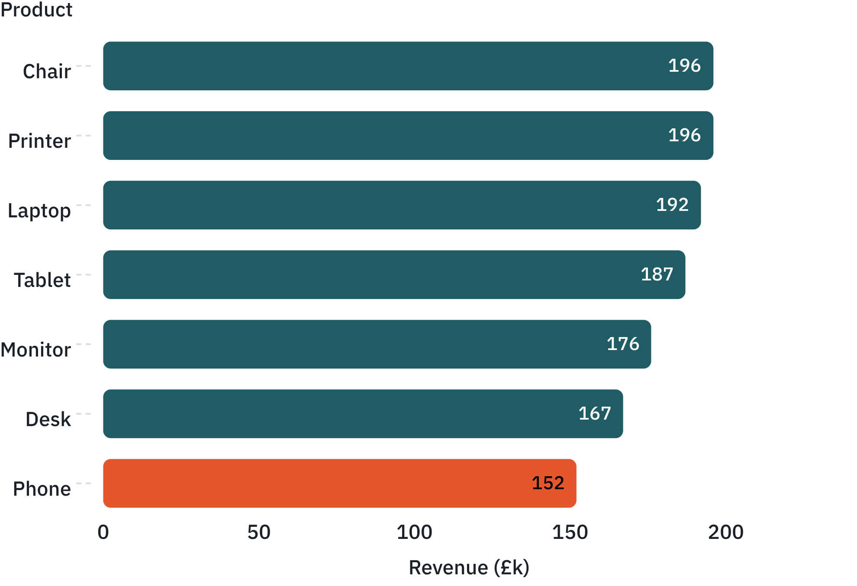
PORTFOLIO CONCENTRATION
No single product dominates, so fix fulfilment across the range
REVENUE BY PRODUCT LINE (£K)
PORTFOLIO TAKEAWAY
Balanced contribution: Chair leads at £195.6k (15.5%) while Phone sits lowest at £151.7k (12.0%).
Top two deliver only 30.9%: Chair and Printer together represent under a third of total billing.
There is no hero SKU to carry operational inefficiency. Check margin, returns and availability before moving inventory or marketing; audit gross margin, return rates and supplier lead times before reallocating inventory.
6
Notes:
Product revenue is remarkably flat: the gap between the top SKU (Chair, £196k) and bottom SKU (Phone, £152k) is only £44k. Fulfilment issues cannot be isolated to one problem item.

Slide 7
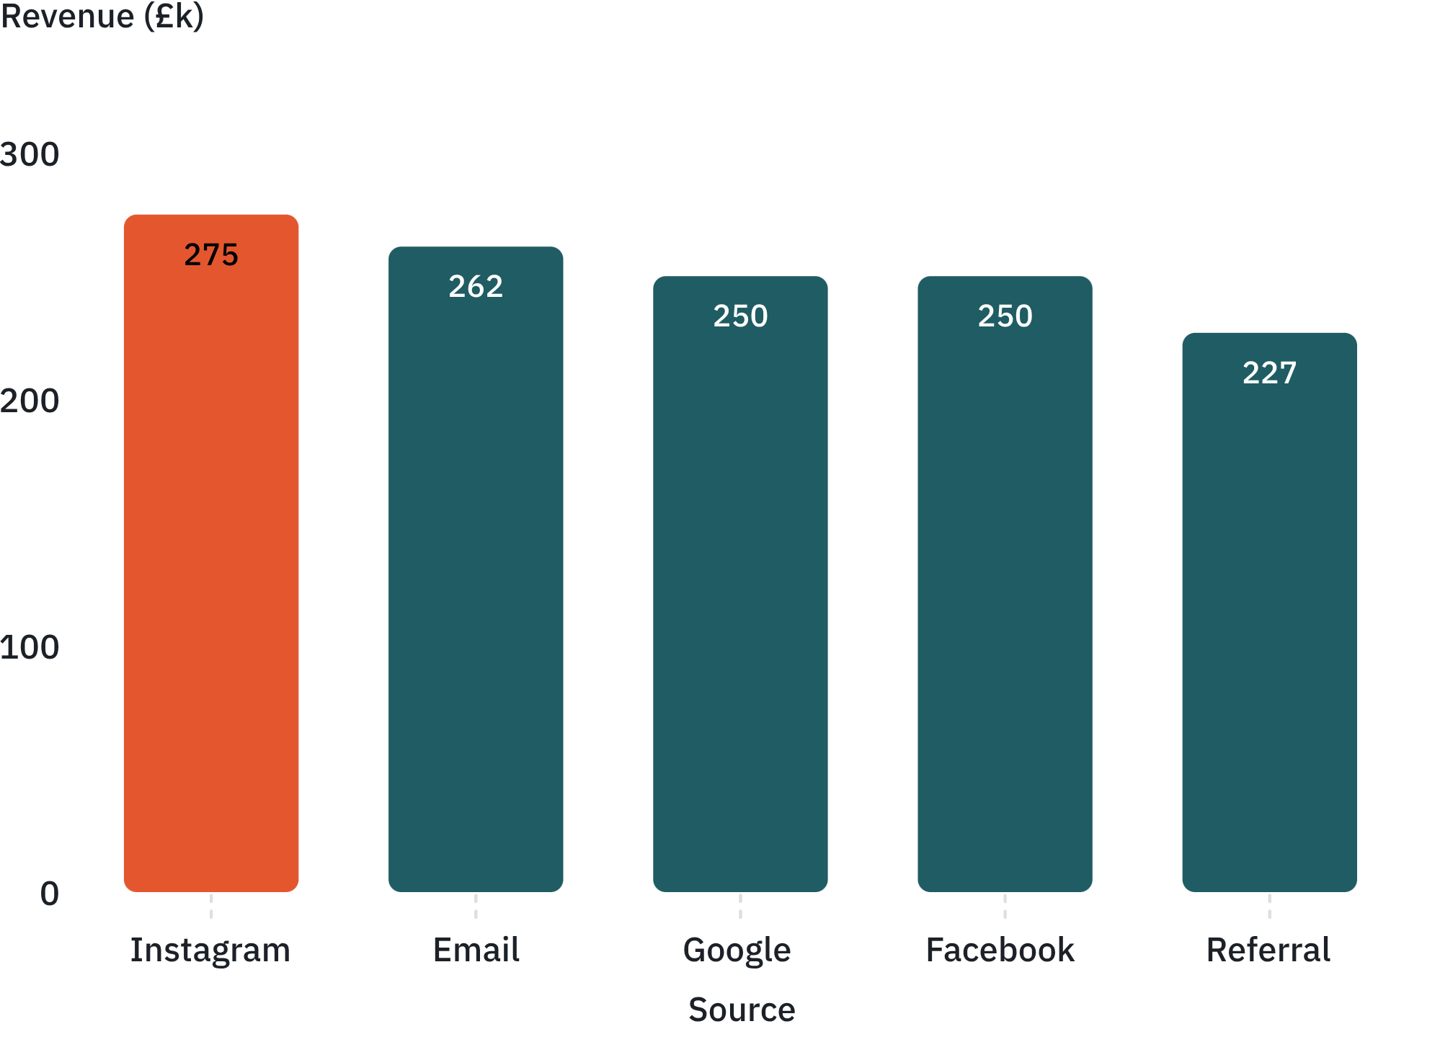
ACQUISITION CHANNELS
Instagram and Email lead revenue, but ROI is unproven
GROSS REVENUE BY REFERRAL SOURCE (£K)
ATTRIBUTION BLIND SPOT
Top channels: Instagram £275k from 259 orders; Email £262k from 250 orders.
No spend, clicks or attribution data, so revenue rank is not efficiency.
Action: link campaign cost and web analytics to orders; test incremental lift by channel.
7
Notes:
Channels show tight parity from £227k to £275k. Without cost per acquisition data, leadership cannot determine whether Instagram or Email is delivering positive unit economics.

Slide 8
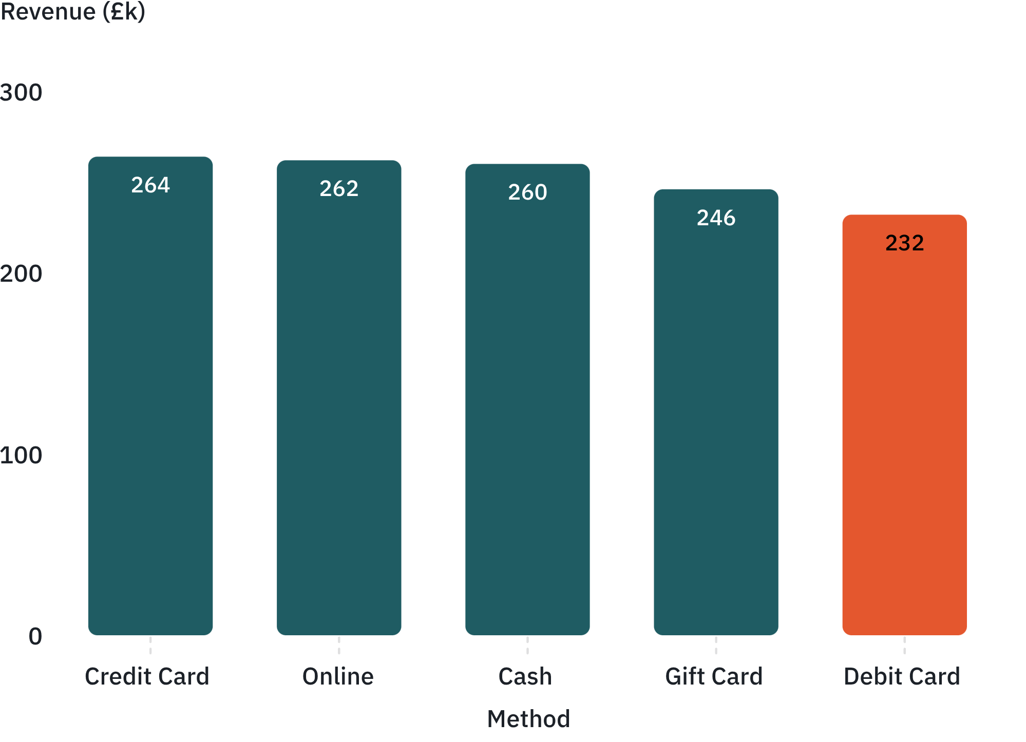
CHECKOUT INFRASTRUCTURE
Payment method is not a material differentiator
REVENUE BY PAYMENT METHOD (£K)
OPERATIONAL METRICS
£31.5k gap: Credit Card highest at £263.8k; Debit Card lowest at £232.4k.
Revenue totals can't show payment friction.
Monitor authorisation success, chargebacks, refund cycle time and cost by method.
8
Notes:
Payment distribution is remarkably uniform across all five methods. The executive takeaway is to stop looking for checkout tender fixes and focus on back-end fulfilment.

Slide 9
CUSTOMER RETENTION
The customer base is almost entirely one-order buyers
1,189
11
0.93%
£5,723
UNIQUE CUSTOMERS
REPEAT BUYERS
REPEAT RATE
TOP CUSTOMER VALUE
Across 1,200 total orders placed
Only eleven customers ever ordered a second time
More than 99% of customers churn immediately
Highest lifetime account (C38840 across 2 orders)
Retention Deficit: With under 1% repeat purchasing, DecodeLabs operates as a high-friction acquisition engine. Poor delivery rates and unresolved returns likely suppress second purchases.
Action: Establish cohort tracking for 30/60/90-day repurchase windows and lifetime value, and launch a targeted post-purchase retention sequence measured against a holdout control group.
9
Notes:
A 0.93% repeat rate is an existential metric: almost every order requires fresh marketing spend. Fix delivery reliability first, then build second-order triggers.

Slide 10
DATA INTEGRITY & NEXT STEPS
What the data can and cannot tell leadership
0
0
25.8%
8
DUPLICATE ROWS
MISSING CORE FIELDS
MISSING COUPON VALUES
HIGH-VALUE OUTLIERS
309 missing coupon values
DATASET LIMITATIONS
EXECUTIVE ACTION
Revenue is gross TotalPrice across all statuses, not net sales or cash. No cost, margin, spend, traffic, refund or delivery-time data; unit volume is 3,535.
Reconcile status, returns, recognised revenue and cash with Finance before board reporting.
10
Notes:
Summary for the board: the transactional data is structurally clean, but gross order totals must not be mistaken for net recognized revenue until returns and cancellations are fully reconciled.

Slide 11
RECOMMENDED ACTIONS
Fix fulfilment. Protect demand. Build retention.
CONTROL
IMPROVE
SCALE
0-30 DAYS
31-60 DAYS
61-90 DAYS
• Reconcile revenue & status definitions
• Audit 497 failed orders
• Establish KPI baseline
• Diagnose root causes
• Pilot fixes
• Measure conversion performance
• Launch retention journeys
• Allocate spend using ROI
• Deploy executive dashboard
NORTH-STAR KPI
Delivered, Non-Returned Order Value (£)

Slide 12
THE LEADERSHIP ASK
Turn Gross Order Activity into Completed Customer Value
✓ APPROVE AUDIT
✓ ALIGN KPIs
Audit 497 cancelled and returned orders.
Standardise business KPI definitions.
✓ FUND MEASUREMENT
✓ CREATE TASKFORCE
Measure channel ROI and retention.
Operations, Finance, Customer Service & Product.
Success is not more orders entering the funnel.
It is more profitable orders reaching customers and staying with them.

